Slide 1
Virtual Troop Meeting
Be Prepared for Public Health
13 March 2020 • Scouts BSA Troop 98, Whitpain Township, Pennsylvania

Slide 2
Troop Meeting Plan
Opening
Scout Motto
Coronavirus
What it is & does, how it spreads
Prevention and Protection
Spread & Flattening the Curve
What to do now
Be Prepared
Take care of yourself
Take care of others
Keep learning
Have a plan
Public Health Merit Badge
Requirement 1
What is public health?
Four diseases: contracting & prevention
Type, vectors, prevention, treatment
Requirement 2
Immunization
8 / 2 / 1 frequencies
Immunizations not available
Next steps / homework
Scoutmaster Minute
Closing

Slide 4
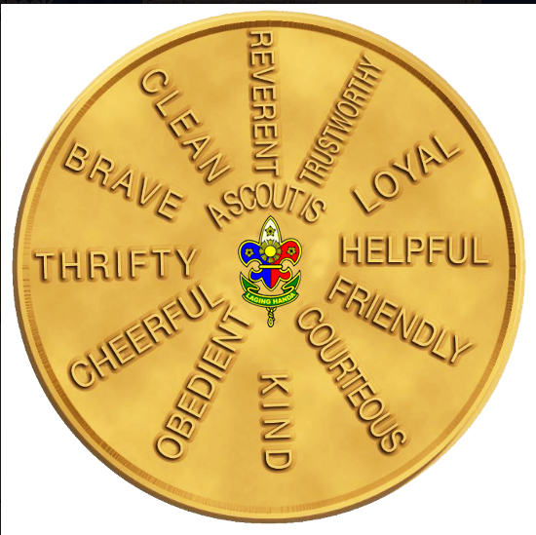
The Scout Law

Slide 5
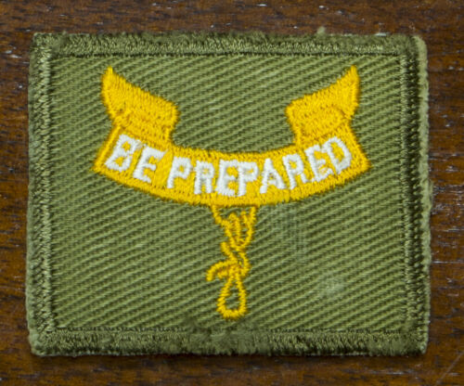
Be Prepared
In 1907, Baden-Powell, an English soldier, devised the Scout motto: Be Prepared. He published it in Scouting for Boys in 1908.
In Scouting for Boys, Baden-Powell wrote that to Be Prepared means “you are always in a state of readiness in mind and body to do your duty.”
More than a century later, preparedness is still a cornerstone of Scouting. Right now is an incredible opportunity for Scouts to put the Scout motto into practice. Tonight’s meeting should help you do this.

Slide 6
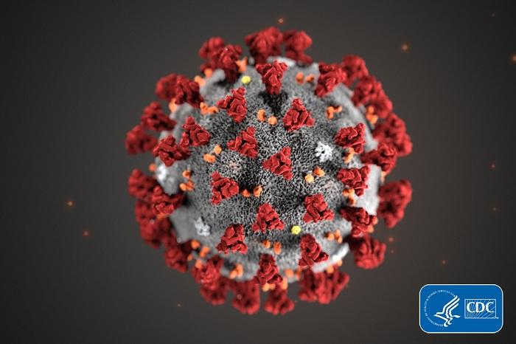
Coronavirus - what it is and what it does
Coronavirus disease 2019 (COVID-19) is a respiratory illness that can spread from person to person. The virus that causes COVID-19 is a novel coronavirus that was first identified during an investigation into an outbreak in Wuhan, China.
Patients with COVID-19 have had mild to severe respiratory illness with symptoms of
Fever • Cough • Shortness of breath
Older adults and people who have severe underlying chronic medical conditions like heart or lung disease or diabetes seem to be at higher risk for developing more serious complications from COVID-19 illness (like pneumonia in both lungs, multi-organ failure and in some cases death).
Notes:
Source: US Centers for Disease Control and Prevention (CDC) - cdc.gov
Do these symptoms sound like other things? Maybe the flu (influenza). That makes it tough to distinguish between the two, especially early on.

Slide 8
Coronavirus - how does it spread?
The virus that causes COVID-19 probably emerged from an animal source, but is now spreading from person to person.
The virus is thought to spread mainly between people who are in close contact with one another (within about 6 feet) through respiratory droplets produced when an infected person coughs or sneezes.
It also may be possible that a person can get COVID-19 by touching a surface or object that has the virus on it and then touching their own mouth, nose, or possibly their eyes, but this is not thought to be the main way the virus spreads.
Notes:
Source: US Centers for Disease Control and Prevention (CDC) - cdc.gov
Do these symptoms sound like other things? Maybe the flu (influenza). That makes it tough to distinguish between the two, especially early on.

Slide 9
Coronavirus - prevention / avoid exposure
There is currently no vaccine to prevent coronavirus disease 2019 (COVID-19).
The best way to prevent illness is to avoid being exposed to this virus.
The virus is thought to spread mainly from person-to-person.
Between people who are in close contact with one another (within about 6 feet).
Through respiratory droplets produced when an infected person coughs or sneezes.
These droplets can land in the mouths or noses of people who are nearby or possibly be inhaled into the lungs.
Notes:
Source: US Centers for Disease Control and Prevention (CDC) - cdc.gov

Slide 10
Coronavirus - prevention / steps to protect yourself
Clean your hands often
Wash your hands often with soap and water for at least 20 seconds especially after you have been in a public place, or after blowing your nose, coughing, or sneezing.
If soap and water are not readily available, use a hand sanitizer that contains at least 60% alcohol. Cover all surfaces of your hands and rub them together until they feel dry.
Avoid touching your eyes, nose, and mouth with unwashed hands.
Avoid close contact
Avoid close contact with people who are sick
Put distance between yourself and other people if COVID-19 is spreading in your community.
Notes:
Some studies show that SOAP and WATER are better than Hand Sanitizer. And SOAP isn’t sold out anywhere...

Slide 11
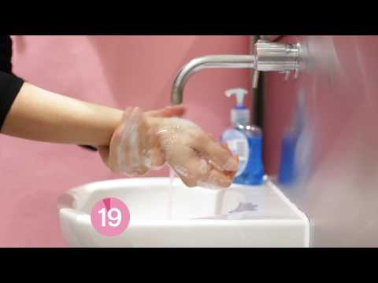
How to Wash Your Hands
Troop Safety Officer
John C.

Slide 12
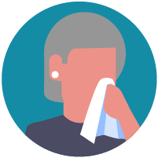
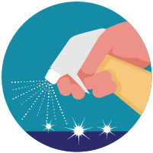
Coronavirus - prevention / steps to protect others
Stay home if you’re sick
Cover coughs and sneezes
Cover your mouth and nose with a tissue or use the inside of your elbow.
Throw used tissues in the trash.
Immediately wash your hands with soap and water for at least 20 seconds.
Wear a facemask if you are sick
Clean and disinfect
Clean AND disinfect frequently touched surfaces daily. Tables, doorknobs, light switches, countertops, handles, desks, phones, keyboards, toilets, faucets, and sinks.
If surfaces are dirty, clean them: Use detergent or soap and water prior to disinfection.
Notes:
All of this is on the CDC website. Note that CLEANING and DISINFECTING are not the same thing.

Slide 13
Coronavirus - how it has spread
Coronavirus has spread very quickly. Why?
It’s new and we haven’t been looking for it
Initially there were delays in reporting about it
The virus itself appears to spread quite effectively
The world is very interconnected, and at higher speed than ever before
Some countries responded very quickly and very forcefully; Hong Kong, Singapore
Notes:
Source: US Centers for Disease Control and Prevention (CDC) - cdc.gov

Slide 14
Coronavirus
How it has spread

Slide 15
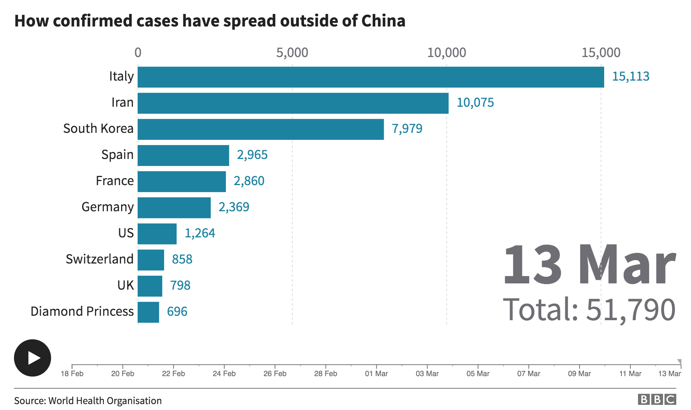
Coronavirus
How it has spread
https://www.bbc.com/news/world-51235105

Slide 16
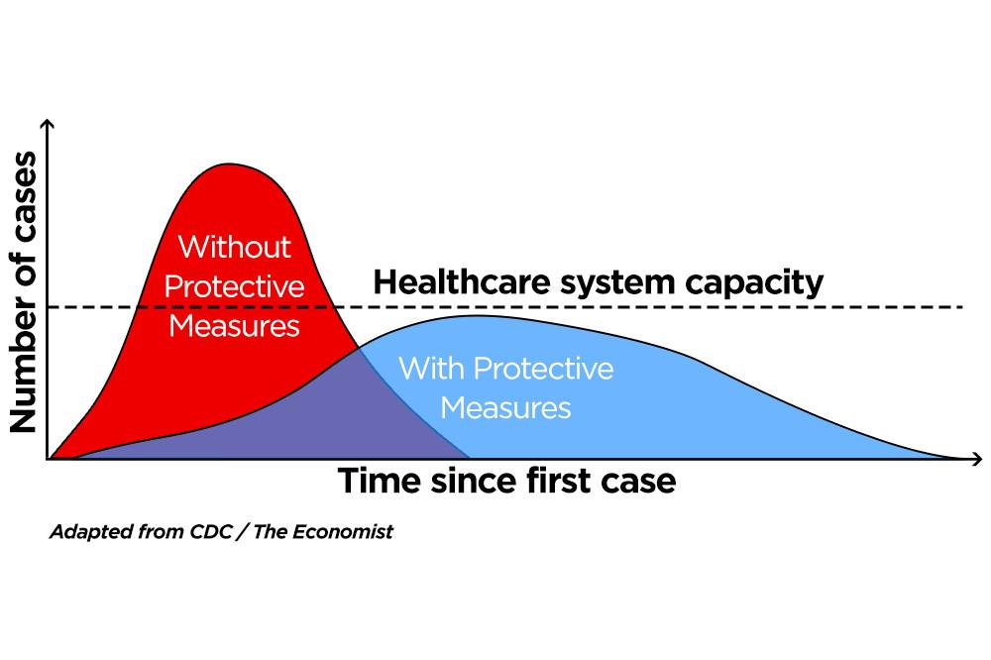
Coronavirus - what we’re being asked to do now
Reduce the spread as much as possible
Reduce the burden on the health care system
More time to:
increase testing
Increase preparedness
learn more about the virus
improve the odds of fighting it
How doctors and hospitals are preparing: Dr. Bob Czincila - Chief, Department of Emergency Medicine Einstein Medical Center Montgomery
Notes:
This is the most important thing we’re going to talk about tonight. I want you to understand this and believe in it. That way you’ll do a better job yourself and help convince others around you that this is really important. It will save lives.

Slide 17
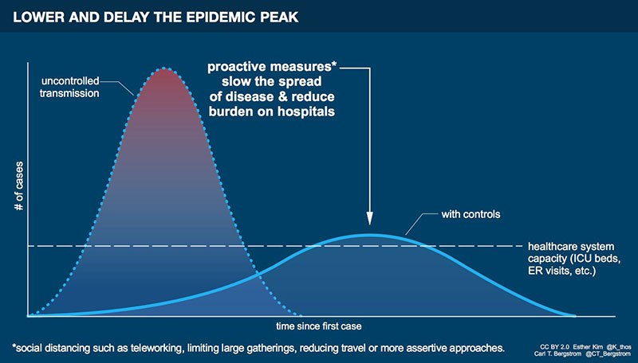
Notes:
This is what we’re being asked to do. We’re helping stop the first hump from happening. And for those of you taking Calculus, the area under the curve on the right is less than the one on the left. What does that mean?

Slide 18
Coronavirus - BE PREPARED
Take care of yourself • PHYSICALLY STRONG, CLEAN, OBEDIENT, TRUSTWORTHY
Follow the rules: hygiene, distance, don’t shake hands
Get your flu shot, take your medications
Sleep well, get exercise, healthy diet
Take care of others • HELPFUL, TRUSTWORTHY, OBEDIENT, CHEERFUL
Directly: reinforce good behavior in your family; educate others
Indirectly: prevent spread (you could be a carrier); social distancing, don’t be bitter

Slide 19
Coronavirus - BE PREPARED
Keep learning • MENTALLY AWAKE, HELPFUL, LOYAL, BRAVE
Identify reliable sources of information that are science-based and data-based
www.cdc.gov
Consult your sources regularly; adjust your behavior
Don’t spread rumors
Have a plan if anyone gets ill at home
https://www.cdc.gov/coronavirus/2019-ncov/about/steps-when-sick.html

Slide 20
Questions and break

Slide 21
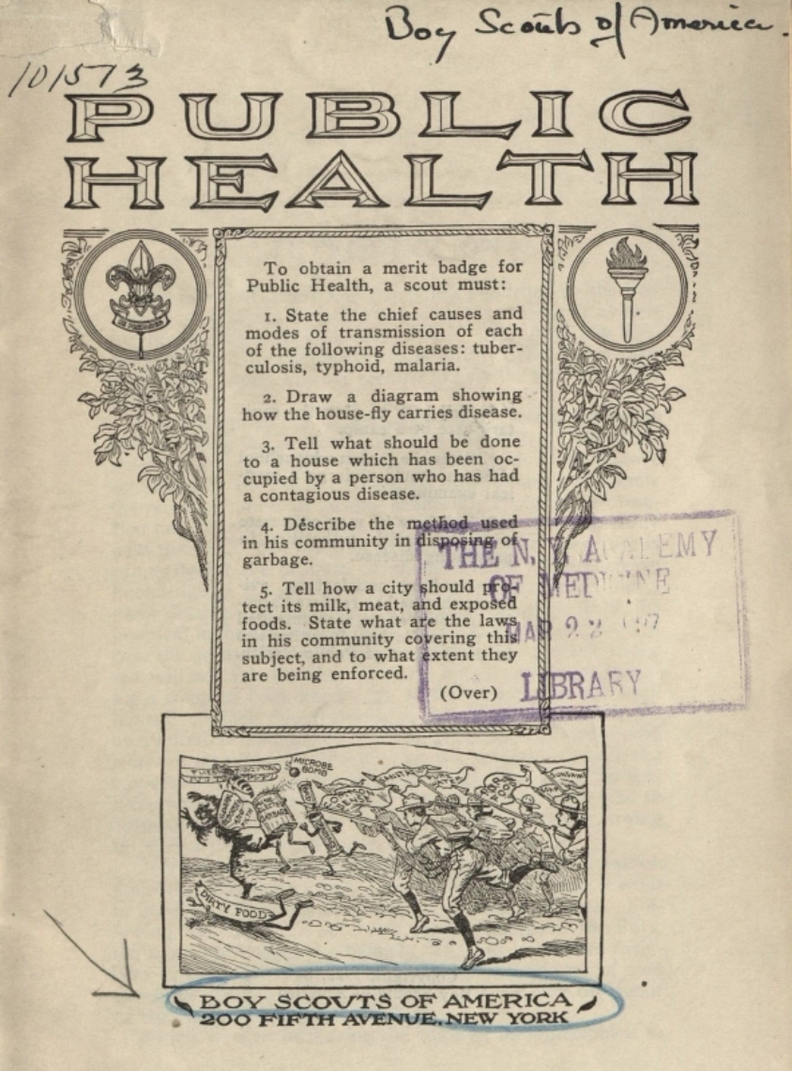
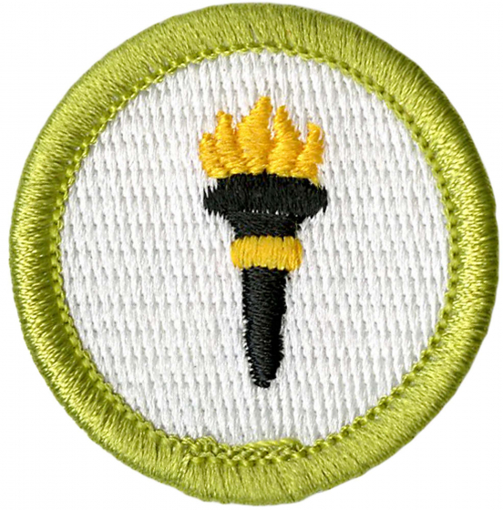
Public Health Merit Badge

Slide 22
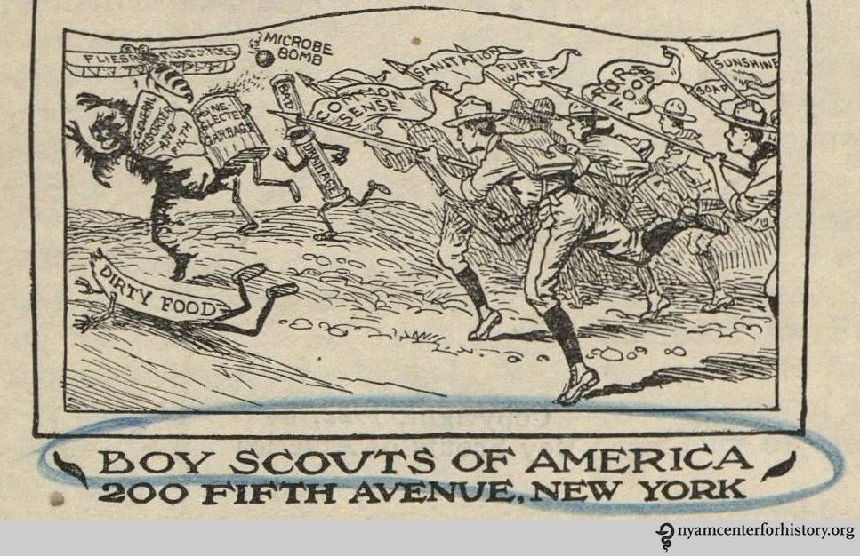

Slide 23
Do the following:
Explain what public health is. Explain how Escherichia coli (E. coli), tetanus, HIV/AIDS, malaria, salmonellosis, and Lyme disease are contracted.
Choose any FOUR of the following diseases or conditions, and explain how each one is contracted and possibly prevented: gonorrhea, West Nile virus, Zika, botulism, influenza, syphilis, hepatitis, emphysema, meningitis, herpes, lead poisoning.
For each disease or condition in requirement 1b, explain:
The type or form of the malady (viral, bacterial, environmental, toxin)
Any possible vectors for transmission
Ways to help prevent exposure or the spread of infection
Available treatments
Do the following:
Explain the meaning of immunization.
Name eight diseases against which a young child should be immunized, two diseases against which everyone should be reimmunized periodically, and one immunization everyone should receive annually.
Using the list of diseases and conditions in requirement 1b, discuss with your counselor those which currently have no immunization available.

Slide 24
Public Health Merit Badge
Prezi: https://prezi.com/4jchujqi2ej6/public-health/
Please complete 1b and 1c in the worksheet
(https://sites.google.com/a/bsa98.com/troop-98/advancement)
We’ll tell you later how to submit it (you will be able to do so electronically or in person once we start physical meetings again).

Slide 25
Scoutmaster Minute
Take care of yourself • PHYSICALLY STRONG, CLEAN, OBEDIENT, TRUSTWORTHY
Follow the rules: hygiene, distance, don’t shake hands
Get your flu shot, take your medications
Sleep well, get exercise, healthy diet
Take care of others • HELPFUL, TRUSTWORTHY, OBEDIENT, CHEERFUL
Directly: reinforce good behavior in your family; educate others
Indirectly: prevent spread (you could be a carrier); social distancing, don’t be bitter

Slide 26
Scoutmaster Minute
Keep learning • MENTALLY AWAKE, HELPFUL, LOYAL, BRAVE
Identify reliable sources of information that are science-based and data-based
www.cdc.gov
Consult your sources regularly; adjust your behavior
Don’t spread rumors
Have a plan if anyone gets ill at home
https://www.cdc.gov/coronavirus/2019-ncov/about/steps-when-sick.html

Slide 27
Scoutmaster Minute
When the Apollo 13 oxygen tank failed and the lunar module was in danger of not returning to earth, Gene Kranz, the lead flight director overheard people saying that this could be the worst disaster NASA had ever experienced—to which he is rumored to have responded, “With all due respect, I believe this is going to be our finest hour.”
Imagine if we could make our response to this crisis our finest hour. Imagine if a year or two from now we looked back on this and told the stories of how we came together as a team in our community, in our state, in our nation and across the world. Your contribution to the finest hour may seem small, invisible, inconsequential—but every small act of ‘not doing’ what you were going to do, and ‘doing’ an act of kindness or support will add up exponentially.

Slide 28
Closing

Slide 29
www.bsa98.com

