Slide 1
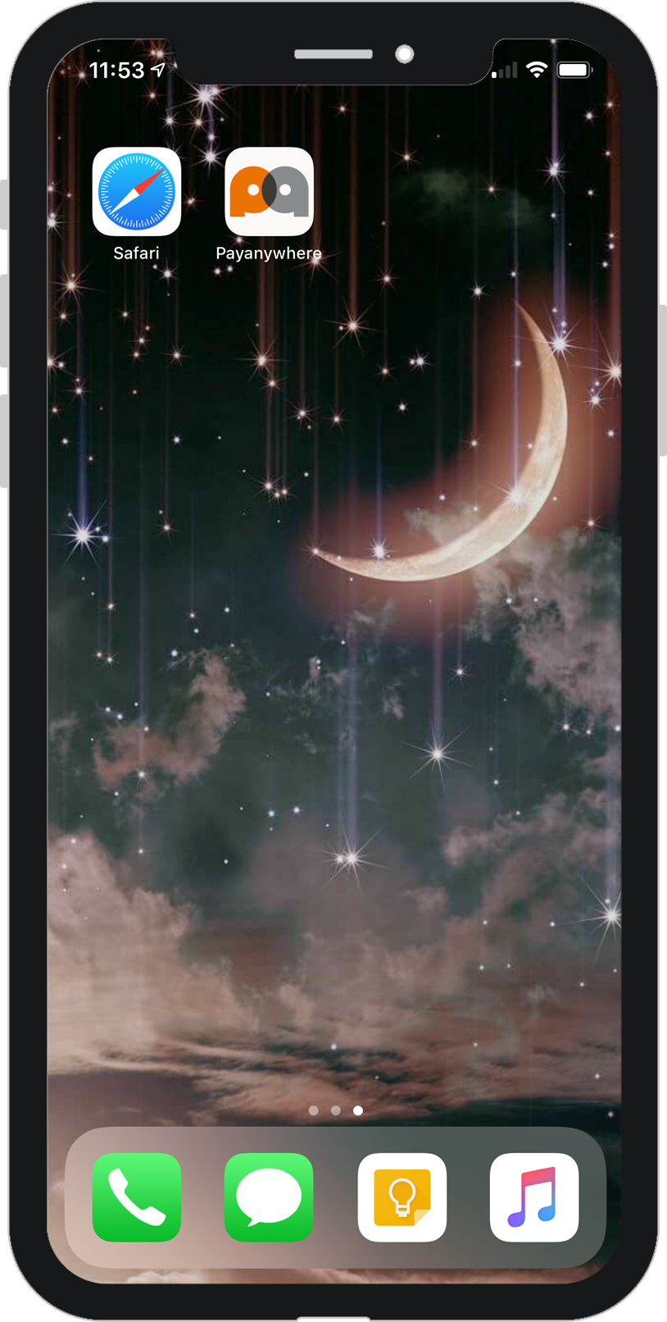
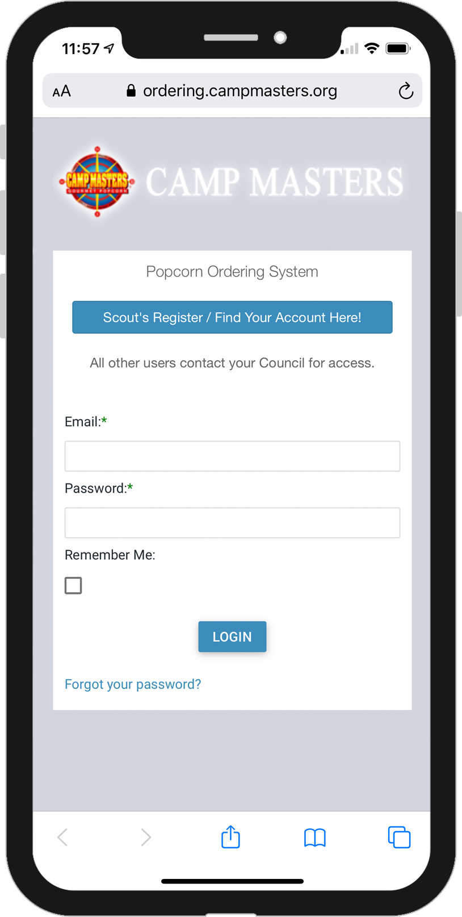
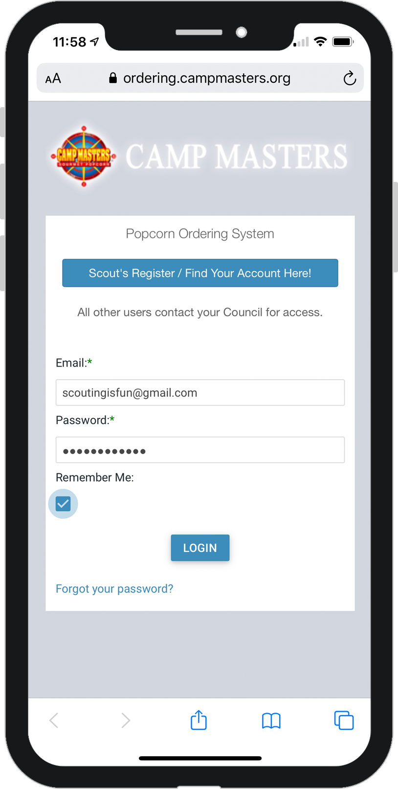
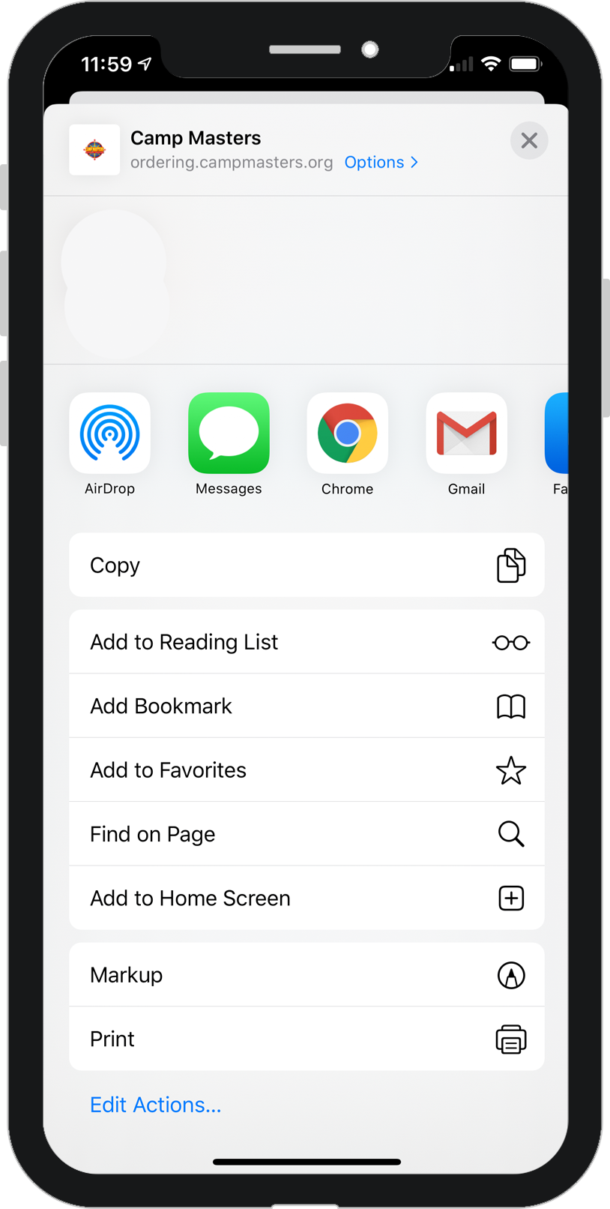
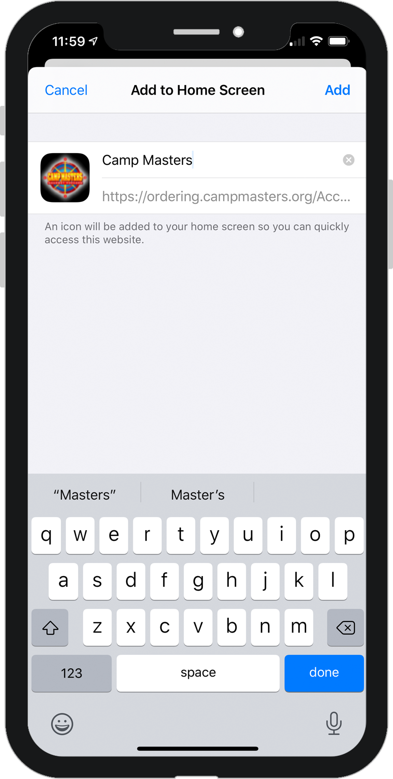
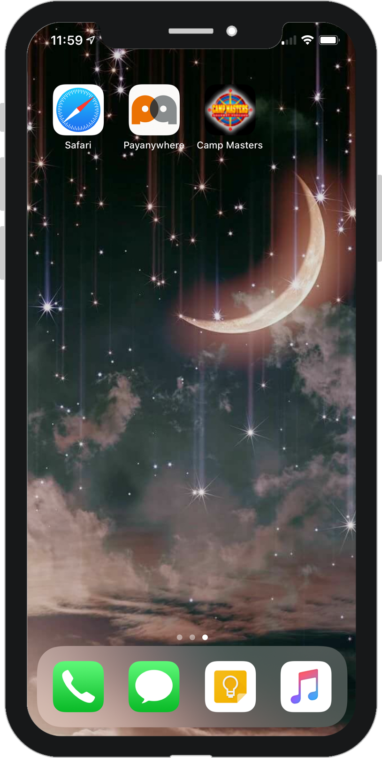
CAMP MASTERS APP
SCOUTS, PARENTS & LEADERS
Follow these instructions to easily create a CAMP MASTERS app icon on your smartphone.
Open Safari
Chrome on Android
Go to ordering.campmasters.com/Account/Login
Enter your login and click “Remember Me” then Login
Once on your dashboard, click the menu button (circled icon above)
(3 dots in upper right on Android)
Select “Add to Home Screen”
Then click “Add”
Ready to sell? Click the icon!

Slide 2
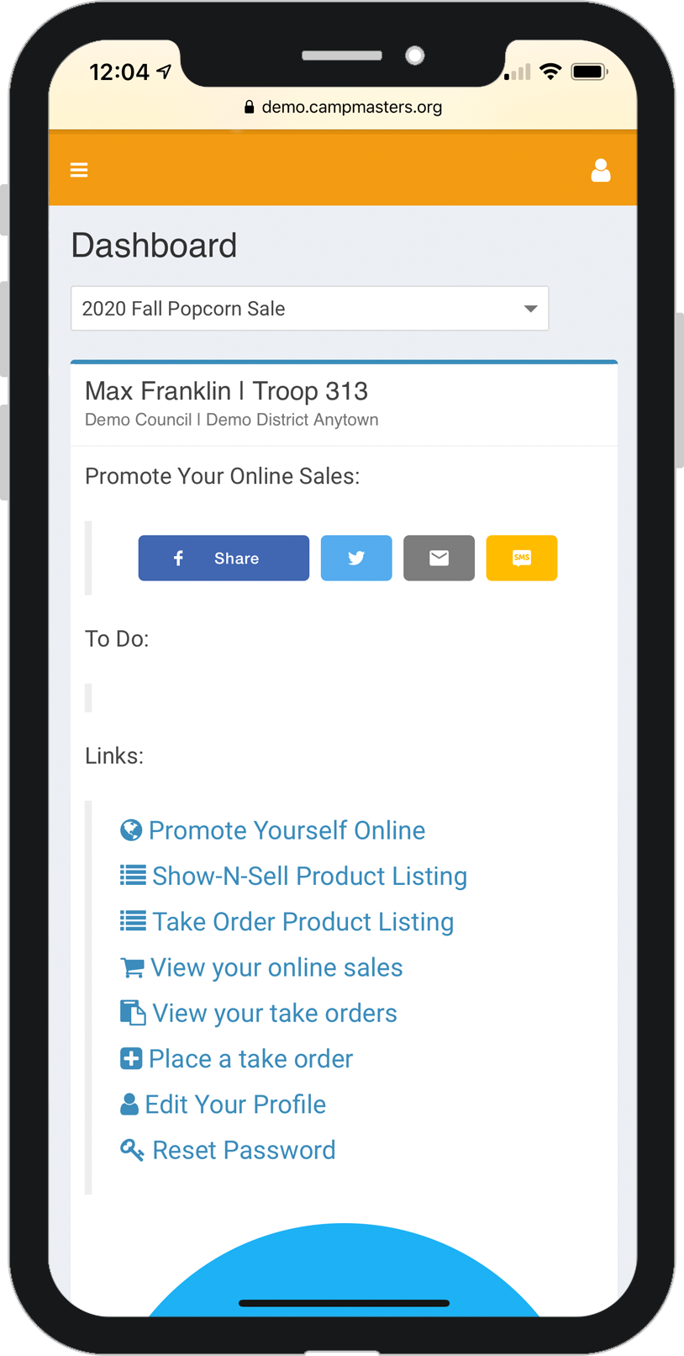
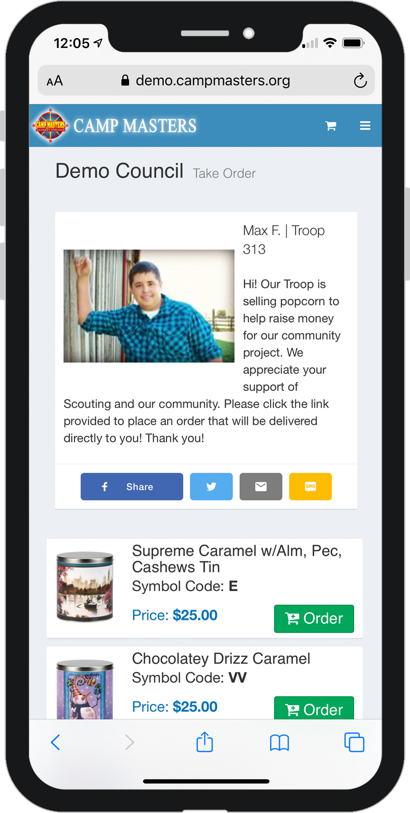
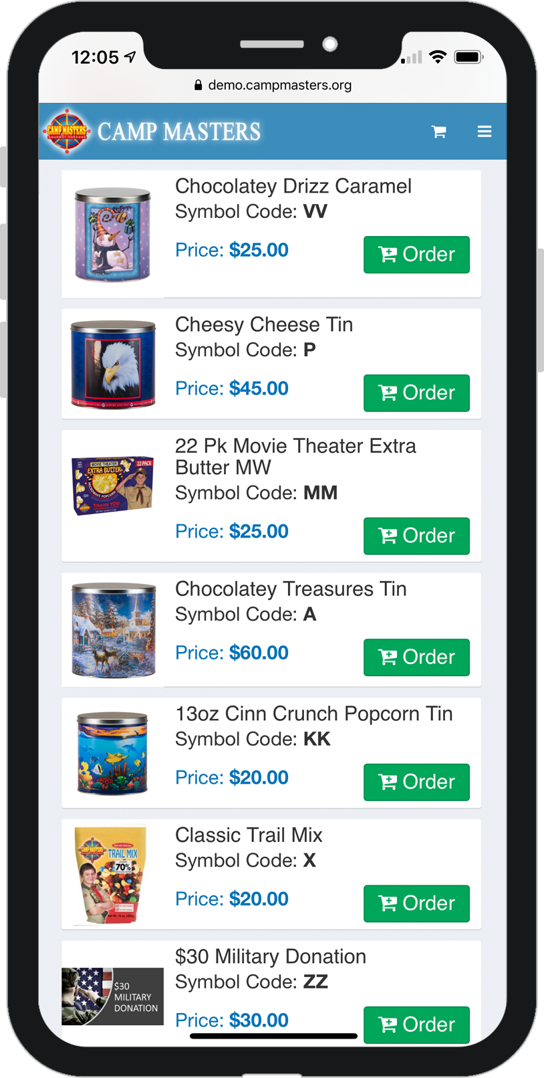
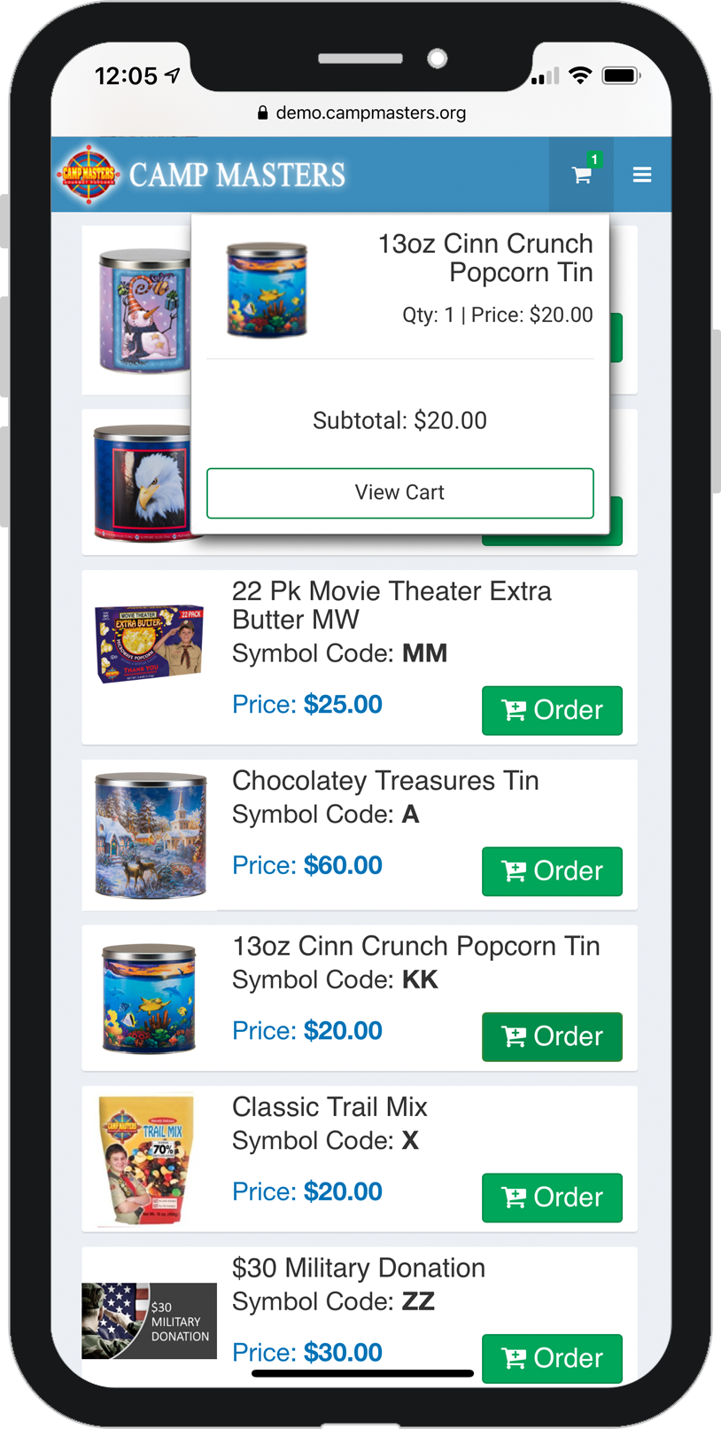
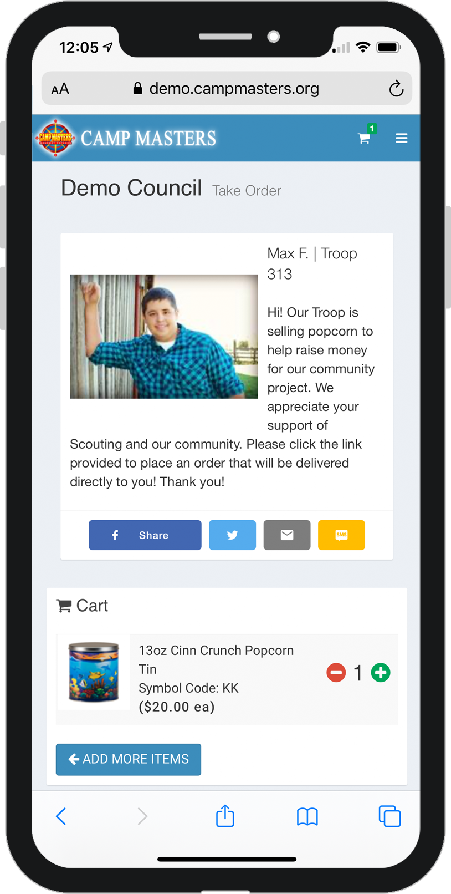
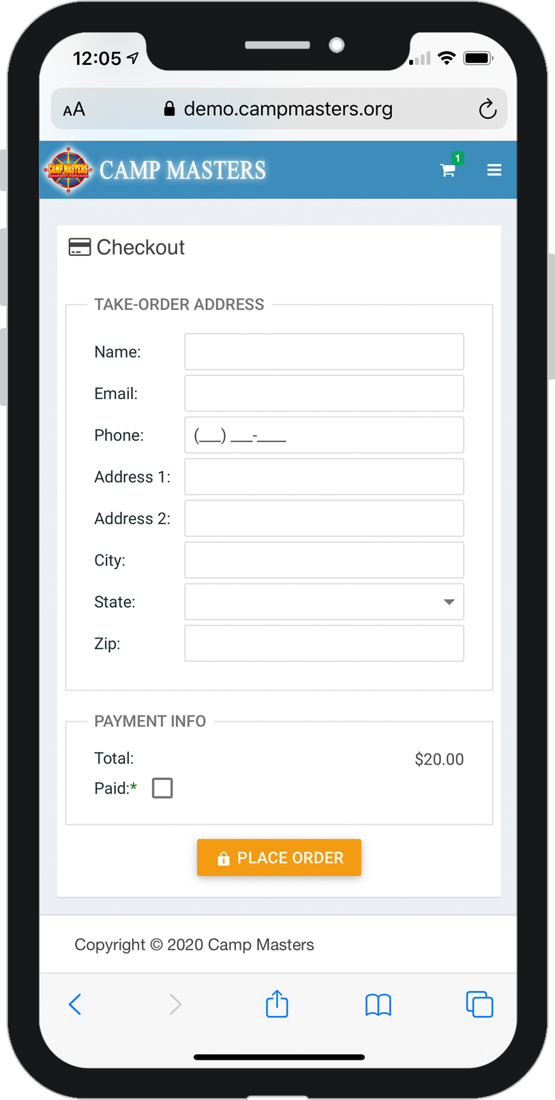
TAKE ORDERS ON THE GO
SCOUTS, PARENTS & LEADERS
Follow these instructions to easily take orders and payment on your smartphone.
Click “Place a Take Order” from the dashboard
This will take you to the products page.
Scroll down to find the requested product. Then click “Order” to add the item to the shopping cart.
A confirmation window will appear. You can either go to cart or continue adding items.
In the cart, you can change the quantity of the product if needed.
Complete the customer information.

Slide 3
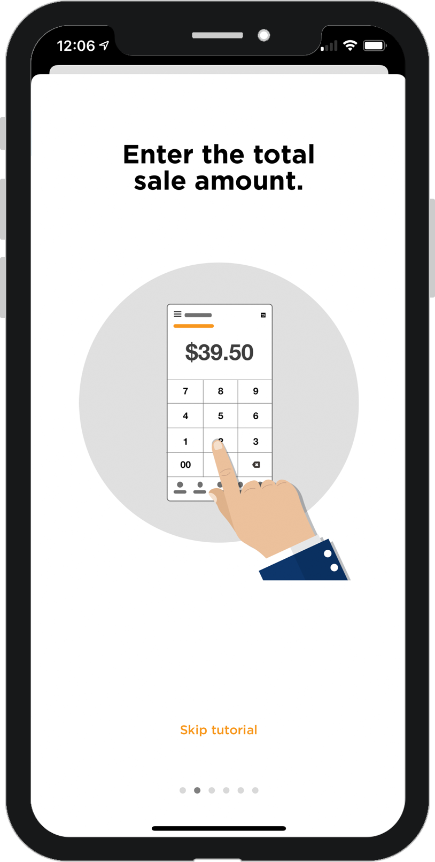
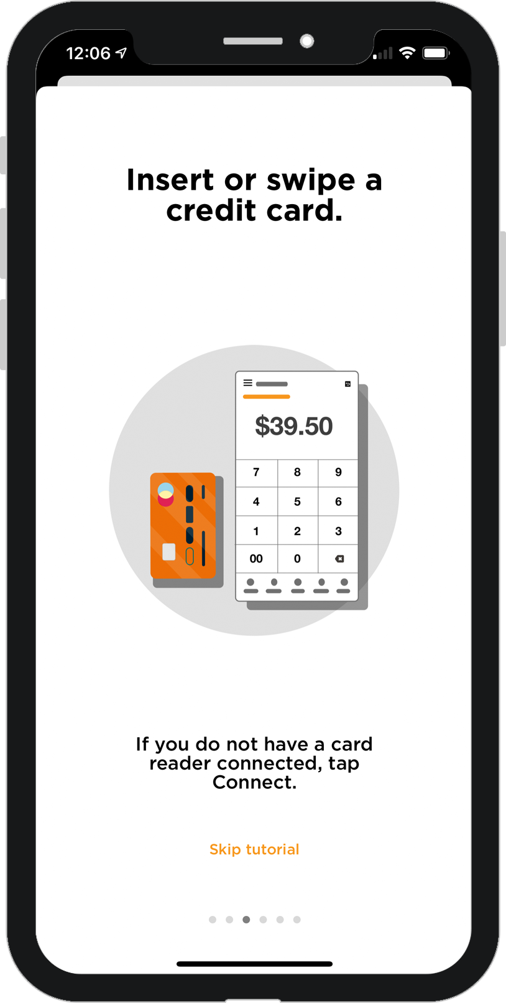
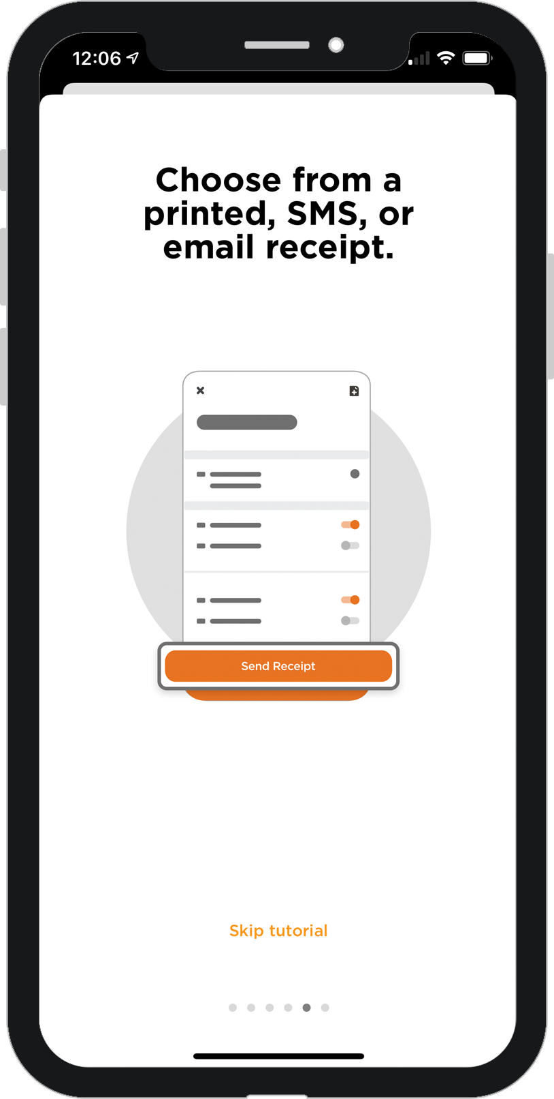
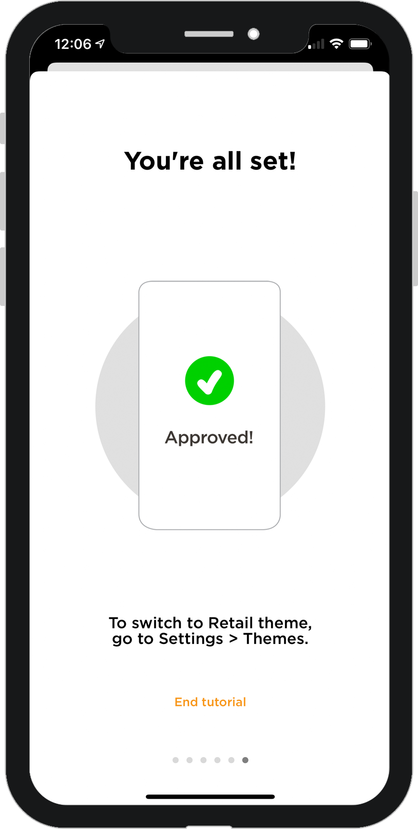
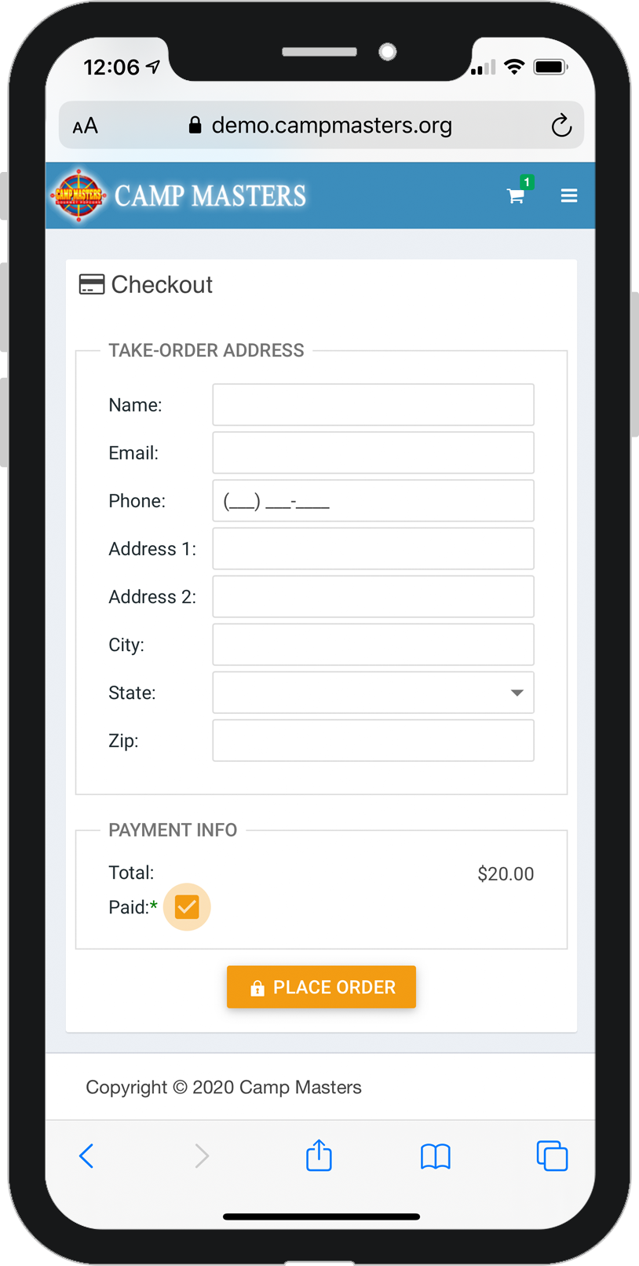
TAKE ORDERS ON THE GO
SCOUTS, PARENTS & LEADERS
Follow these instructions to easily take orders and payment on your smartphone.
Return to your home screen and open the PayAnywhere app.
Enter the total charge.
Insert or swipe the credit card depending on your reader type..
Offer the customer a SMS text or email reciept.
When you receive payment confirmation, return to CAMP MASTERS window.
Mark as paid and then tap the “Place Order” button.

