Slide 1


Fall Cub Recruitment 2023: “Get Out & Cub Scout”
Notes:
David will be provide some house keeping rules prior to starting and as folks are joining the zoom:
Please stay on mute unless presenting or asking a question during our designated pauses
Please utilized the chat function to ask questions – all questions will be addressed – however we may wait to table some question that are very specific or off topic to the end of the meeting or in a follow-up communication.
Announce, we will be recording the meeting

Slide 2

Welcome
&
Introductions
Notes:
David will kick us off and introduce Sarah Rhodes
Sarah will greet everyone & most importantly THANK THEM for joining us. as chair and then briefly introduce our other presenters this evening:
* Jason Pierce, Scout Executive/CEO of the Lincoln Heritage Council
Matt Nash, Field Director for Buffalo Trails, Seneca, and Lewis & Clark
Paul Van der Kruik, Field Director for Lincoln Trail, Wapiti, Great Meadows, and Four Rivers

Slide 3


Safety
Moment
https://www.scouting.org/health-and-safety/safety-moments/gss/
Notes:
Paul will provide our Safety Moment for the meeting.
Let everyone know that we have a goal in our council of Creating a Culture of Safety and that they can play a big part of that.
Encourage every Pack at every meeting to have a Safety Moment that would be appropriate for all of their Scouts and families.
Additionally, make sure that our packs are utilizing the “Guide to Safe Scouting” as they are planning trips, outings, or need to verify the activity they are doing falls within the age appropriate guidelines for their programs age groups (Cubs, Scouts BSA, Venturing, Exploring).
Scouting Safety Moments can be found utilizing the link on the slide: https://www.scouting.org/health-and-safety/safety-moments/gss/
Thank you.

Slide 4



Jason Pierce
Scout Executive/CEO
Notes:
Jason hitting on the important of growing & rebuilding our Cub Scouting program. Review the trend chart.

Slide 5
LINCOLN HERITAGE COUNCIL’s
TOTAL 2023 MEMBERSHIP GOAL:
10,000 YOUTH!!
Another 25% Growth in 2023!
Every Kid Counts!
Notes:
Jason hitting on the important of growing & rebuilding our Cub Scouting program. Review the trend chart.

Slide 6
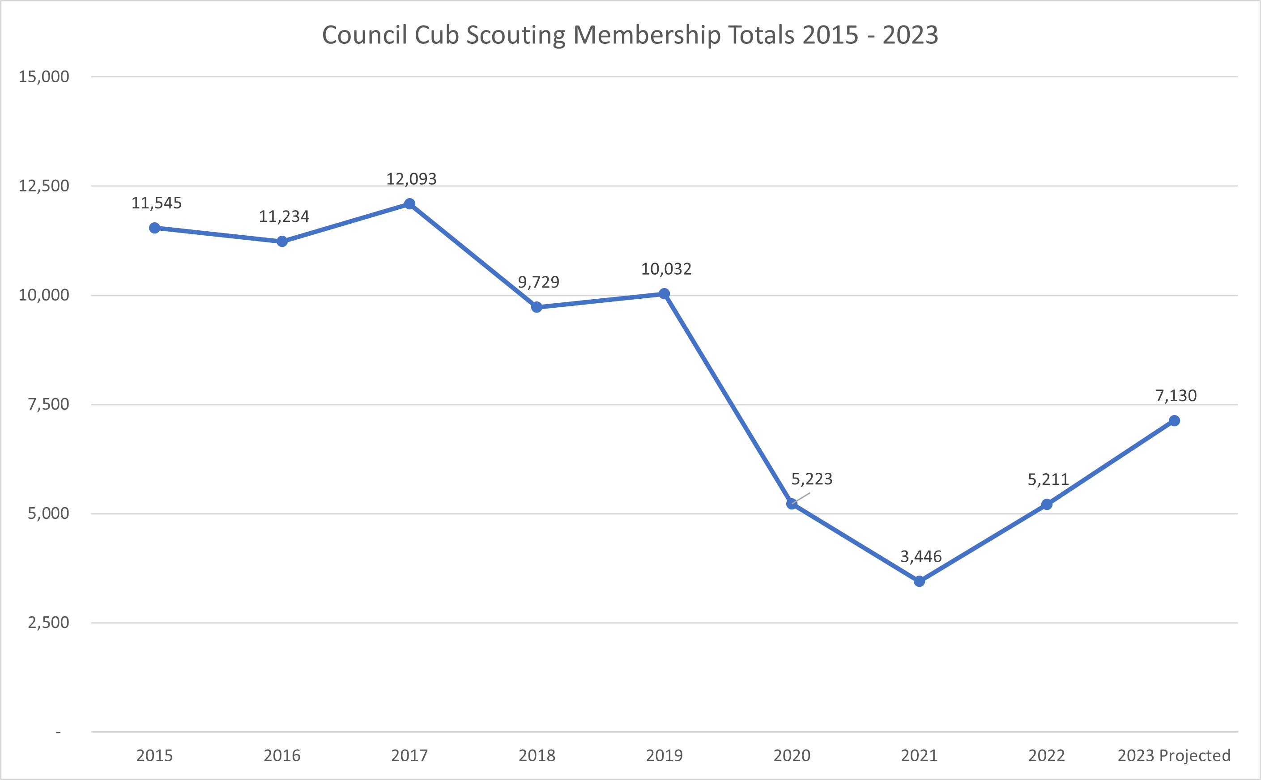

Slide 7
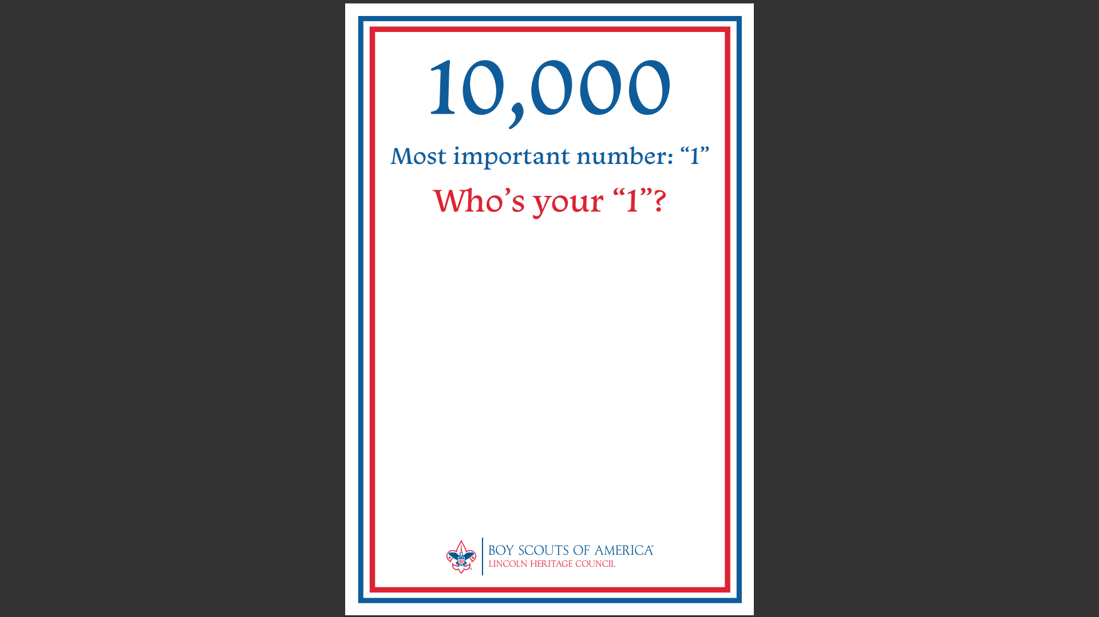

Slide 8
Cub Scout Pack Recruitment Chair Job Description
Notes:
Sarah – will briefly hit on the points of the job description.

Slide 9
Key Responsibilities:
Work closely with the District Cub Recruitment Chair, district executive, and pack leadership to successfully conduct recruitment(s)/sign-up night(s) for your pack.
Recruit a team of volunteers within your Pack to assist with promotions and recruitment efforts and sign-up night(s).
Along with your pack leadership, attend/view council-wide Get Out & Cub Scout Preparation and Readiness Briefing conducted on July 20th attend the Cub Scout Fall Recruitment Training conducted by your district.
Provide leadership to your pack and follow the “2023 Pack Recruitment Action Items & Timeline”.
Coordinate, with the assistance of other pack leaders and parents, additional promotion of your recruitment night. Assist the district with promotion at the school and chartered organization.
“Must do’s” for success:
Cub Scout pack coordinates promotion or has a booth at the school open house/Back to School Night.
Pack leadership and parents promote the sign-up meeting on social media pages, neighborhood apps, and emails to friends, neighbors, and coworkers.
Pack leadership updates and manages BeAScout.org pin, leads, and online applications.
Conduct the sign-up night for your Pack following the council plan.
Recruit new Scouts from schools and charter organization. Also re-engage previous members and invite them to rejoin.
Ensure that all applications (youth/adult) and fees (registration & Scout’s Life) are submitted to the council office 1-2 days after the recruitment.
Notes:
David Sikes

Slide 10

GET OUT & CUB SCOUT!
2023 LHC FALL RECRUITMENT GOALS
Recruit 4000 new Cub Scouts!
Schedule promotion & recruitment for every School and every Pack.
Reorganize, Restart, & Strengthen dropped & existing Cub Scout Packs.
Organize new Cub Scout Packs where needed.
Notes:
David Sikes

Slide 11

District & Council GOALS
Notes:
Matt Nash – briefly state how our Districts goals come together to assist in hitting our overall goal. All goals are reasonable and achievable based on each districts history.

Slide 12

Pack Goals
&
Unit Incentive
Attend your District Training/Kickoff Meeting
Commit and follow LHC 2023 Fall Recruitment Plan
Achieve 2023 Unit Growth Goal of 25% over your December 31st 2022 Pack membership registrations by December 31st, 2023
Notes:
Matt Nash

Slide 13
Pack Preparation & Unit Timeline
Pack Readiness Evaluation
BeAScout.org prep.
Recruit a Team.
Attend District Trainings
Promote at School Open House
Obtain Buzz Up & Sign-Up Night Dates from your District Executive
Start promoting with Posters/Yard Signs at School, Chartering Orgs, and High Traffic Area’s.
Update & Promote on Pack Social Media
Notes:
David

Slide 14

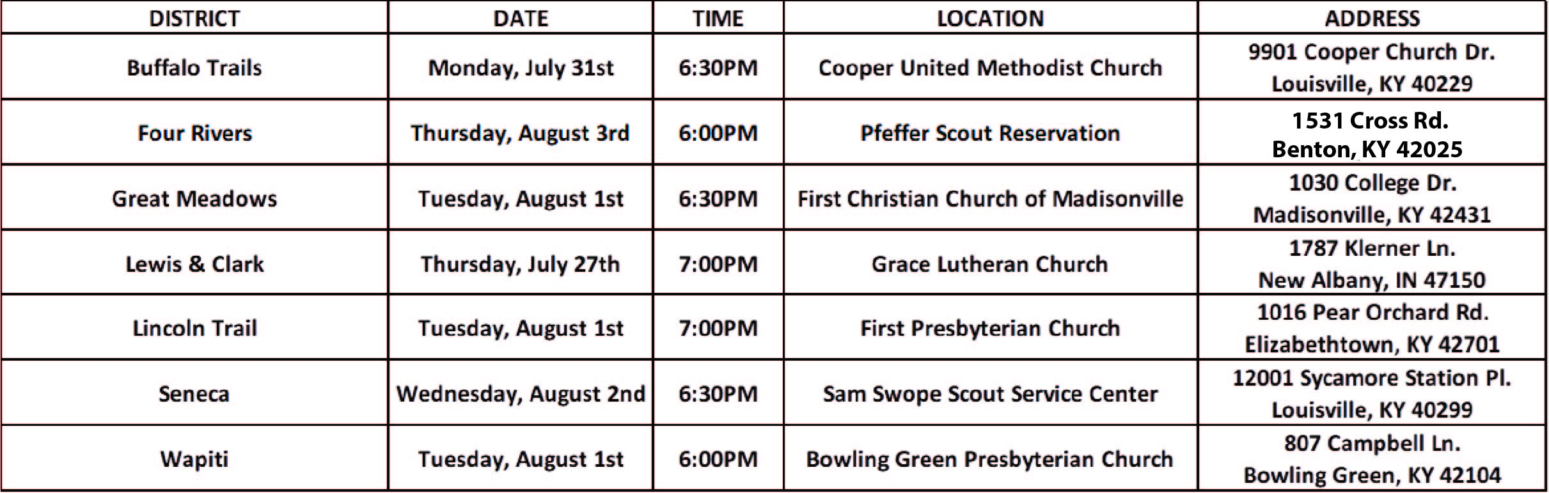
District’s Cub Scout
Recruitment Trainings
Notes:
Sarah – encourage and ask every Pack to attend to learn more about promotion and conducting their sign-up nights and pick up many of the materials they are going to need.

Slide 15

IMMEDIATE ACTION ITEMS REVIEW & PROMOTION MATERIALS
Notes:
David:
Recruit a team of 5 or more
Assess your leadership needs
Have an engaged conversation with your District Executive regarding School Assignments, Dates, and the Execution of your Recruitment
Prepare a Pack Calendar/Handout
Updating your Pack on BeAScout Readiness
ATTEND TRAINING IN YOUR DISTRICT

Slide 16
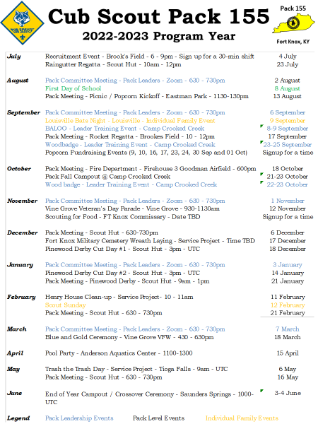
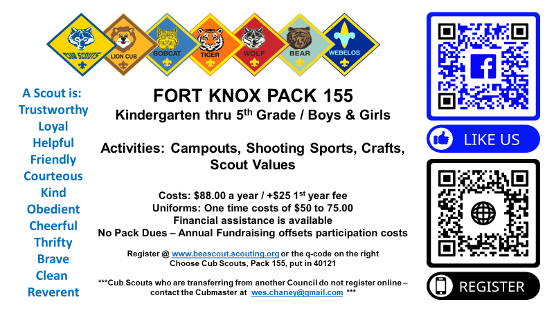
Example Fact Sheet & Calendar
Notes:
David

Slide 17
2023 Materials Review
Notes:
Brief Materials Review

Slide 18




Parent Flyer (1st Flyer)
Youth Flyer (2nd Flyer)

Slide 19
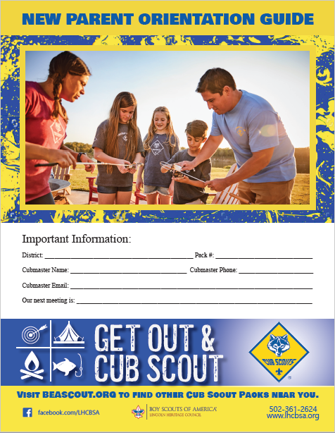
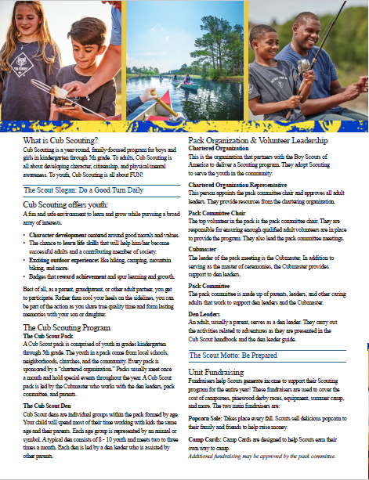
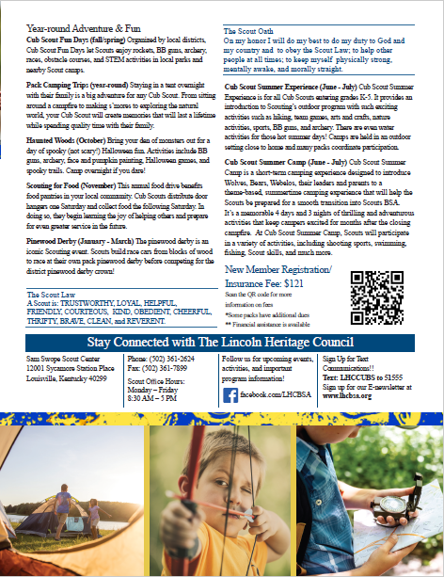

Parent Orientation Guide

Slide 20

Posters
Yard Signs

Slide 21



Fall Adventure Ticket
Balsa Wood Airplane

Slide 22

Be A Scout
Your unit’s Cubmaster, Scoutmaster, Crew Advisor, Committee Chair, or Charter Rep. has the ability to update and manage the pin by logging on to my.scouting.org
4 quick steps to be on your way to updating your pin:
Creating an account, logging on to my.scouting.org
Go to “Menu” at the top left of the home page and then click your unit number.
Click “Organization Manager” and select “unit pin”
Update your unit’s information

