Slide 1
Lincoln Heritage Council 2026 Discount Card Kickoff

Slide 2
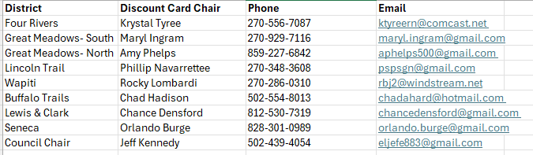
The 2026 Discount Card Team
Council Discount Card Chair
Discount Card Staff Advisor
Discount Card Office Support
Jeff Kennedy
eljefe883@gmail.com
502.439.4054
Hallie Brockhoff
Hallie.brockhoff@scouting.org
502.418.6743
Shannon Smith
Shannon.smith@scouting.org
502.400.5370

Slide 3

Please join me in the Pledge of Allegiance Scout Oath and Scout Law

Slide 4
WHY SELL DISCOUNT CARDS?
IT’S EASY, NO RISK, AND YOU GET 50% COMMISSION!
SCOUTS CAN EARN THEIR WAY TO CAMP.
UNITS CAN EARN MONEY FOR NEW EQUIPMENT OR TO KEEP DUES LOW.
SCOUTS LEARN SALE SKILLS.

Slide 5
IMPORTANT DATES
FEB 10
FEB 11-MAY 15
APR 2
MAY 15
Council-Wide Kickoff
SELL, SELL, SELL!
7PM EST
Kickoff and card distribution
Mid-Sale Check-in
Discount Card Sales End
Settle 50% or more of your cards and your unit will be entered into a drawing for a $500 Amazon Gift Card
All funds and any unsold, undamaged cards are due by May 15 to receive the full 50% commission. Units that submit funds after May 15 will receive a reduced commission.

Slide 6
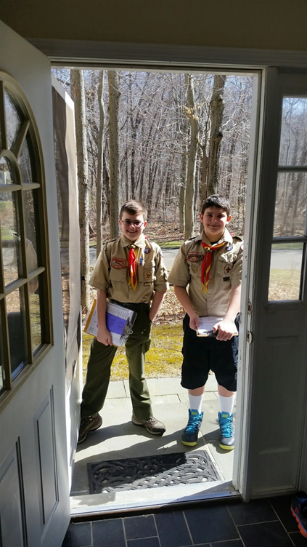
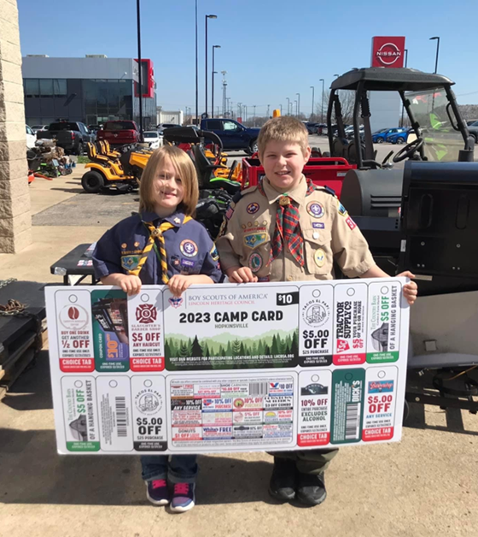

3 Ways to Sell
DOOR-TO-DOOR
SELL AT WORK
STOREFRONT SALES

Slide 7
Scout Safety
When selling discount cards in your neighborhood. ALWAYS have an adult or buddy with you.
NEVER enter a stranger’s house.
Don’t carry large amounts of money.
ALWAYS watch for traffic.
ALWAYS SAY THANK YOU! Whether they buy or not.
ALWAYS wear your uniform. Everybody loves to support a Scout in uniform.

Slide 8
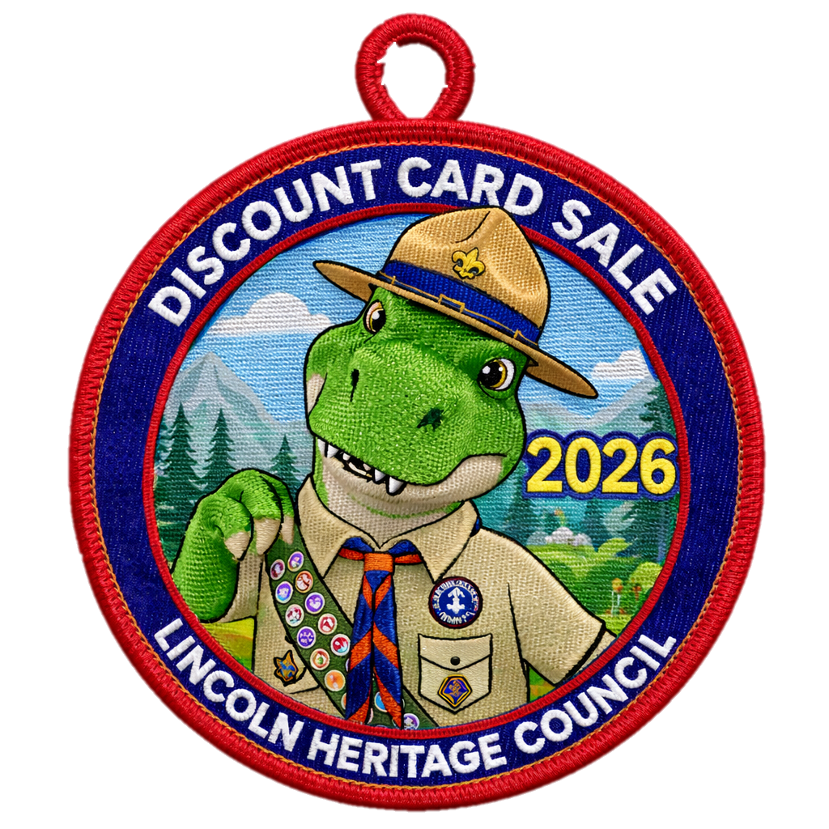

INCENTIVES
WEEKLY PRIZE DRAWING
Scouts who sell 10 cards will be entered into a drawing for a $25 Scout Shop Gift.
Amazon Gift Card
Individual Scout incentives for every 100 cards sold!
Discount Card Patch!
Sell 10 cards and earn the 2026 Discount Card Patch

Slide 9
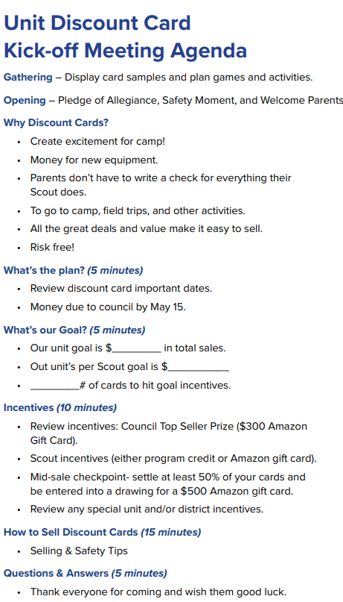
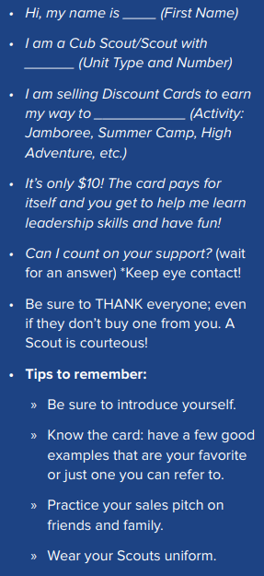

UNIT KICKOFF
Example Script
MAKE IT FUN.
BUILD EXCITEMENT .
HAVE A GOAL.
WEEKLY UPDATES AND HIGHLIGHT SUCCESS!

Slide 10

DISCOUNT CARD GUIDE AVAILBLE ONLINE!

Slide 11
“You don’t have to be great to start, but you have to start to be great.” –Zig Ziglar

